Slide 1

Rockbuster Stealth Data Analysis
By Kateryna Hess

Slide 2
Rockbuster Stealth LLC is a movie rental company that used to have stores around the world. Facing stiff competition from streaming services such as Netflix and Amazon Prime, the Rockbuster Stealth management team is planning to use its existing movie licenses to launch an online video rental service in order to stay competitive.
Introduction
Motivation
Our analysis of the DVD rental database is a strategic endeavor aimed at understanding customer preferences and market trends to guide our transition to an online streaming service. This data-driven approach is crucial for curating a relevant digital content library and ensuring competitive advantage in the rapidly evolving entertainment industry.
Data Limitations
The scope of our dataset encompasses 1000 films and transactions from two stores in 2006, with a noted deficiency in detailed customer demographics and behavioral data.

Slide 3
Data Overview
• Customer: 599 (584 active)
• Country: 109
• Film: 1000
• Film language: English
• Release year: 2006
• Store location: Australia (1) and Canada (1)

Slide 4
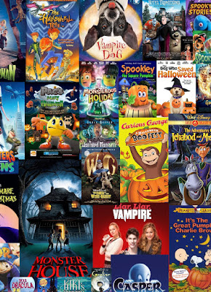
Objectives
Geographic Market Analysis
Statistical Analysis
Understand Customer Behavior
Loyal Customers and Future Opportunities
Data-Driven Recommendations

Slide 5
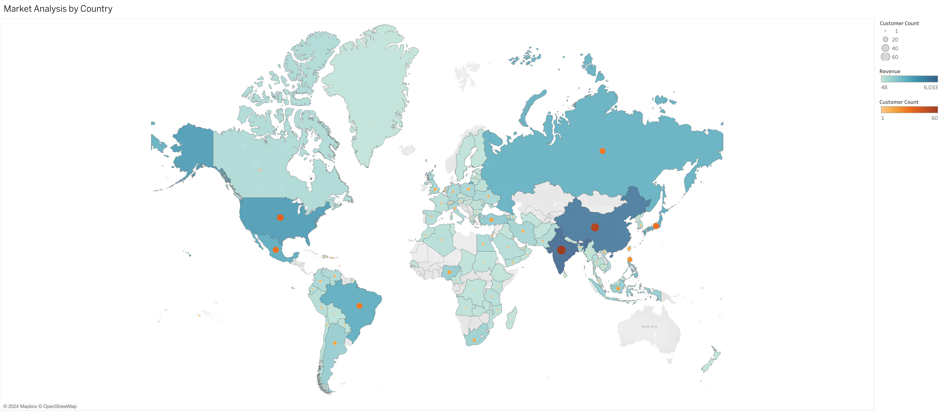




The data reveals that India, China, United States, and Japan have the high revenue. The countries with the lowest revenue are American Samoa, Lithuania, Saint Vincent and the Grenadines
Geographic Market Analysis

Slide 6
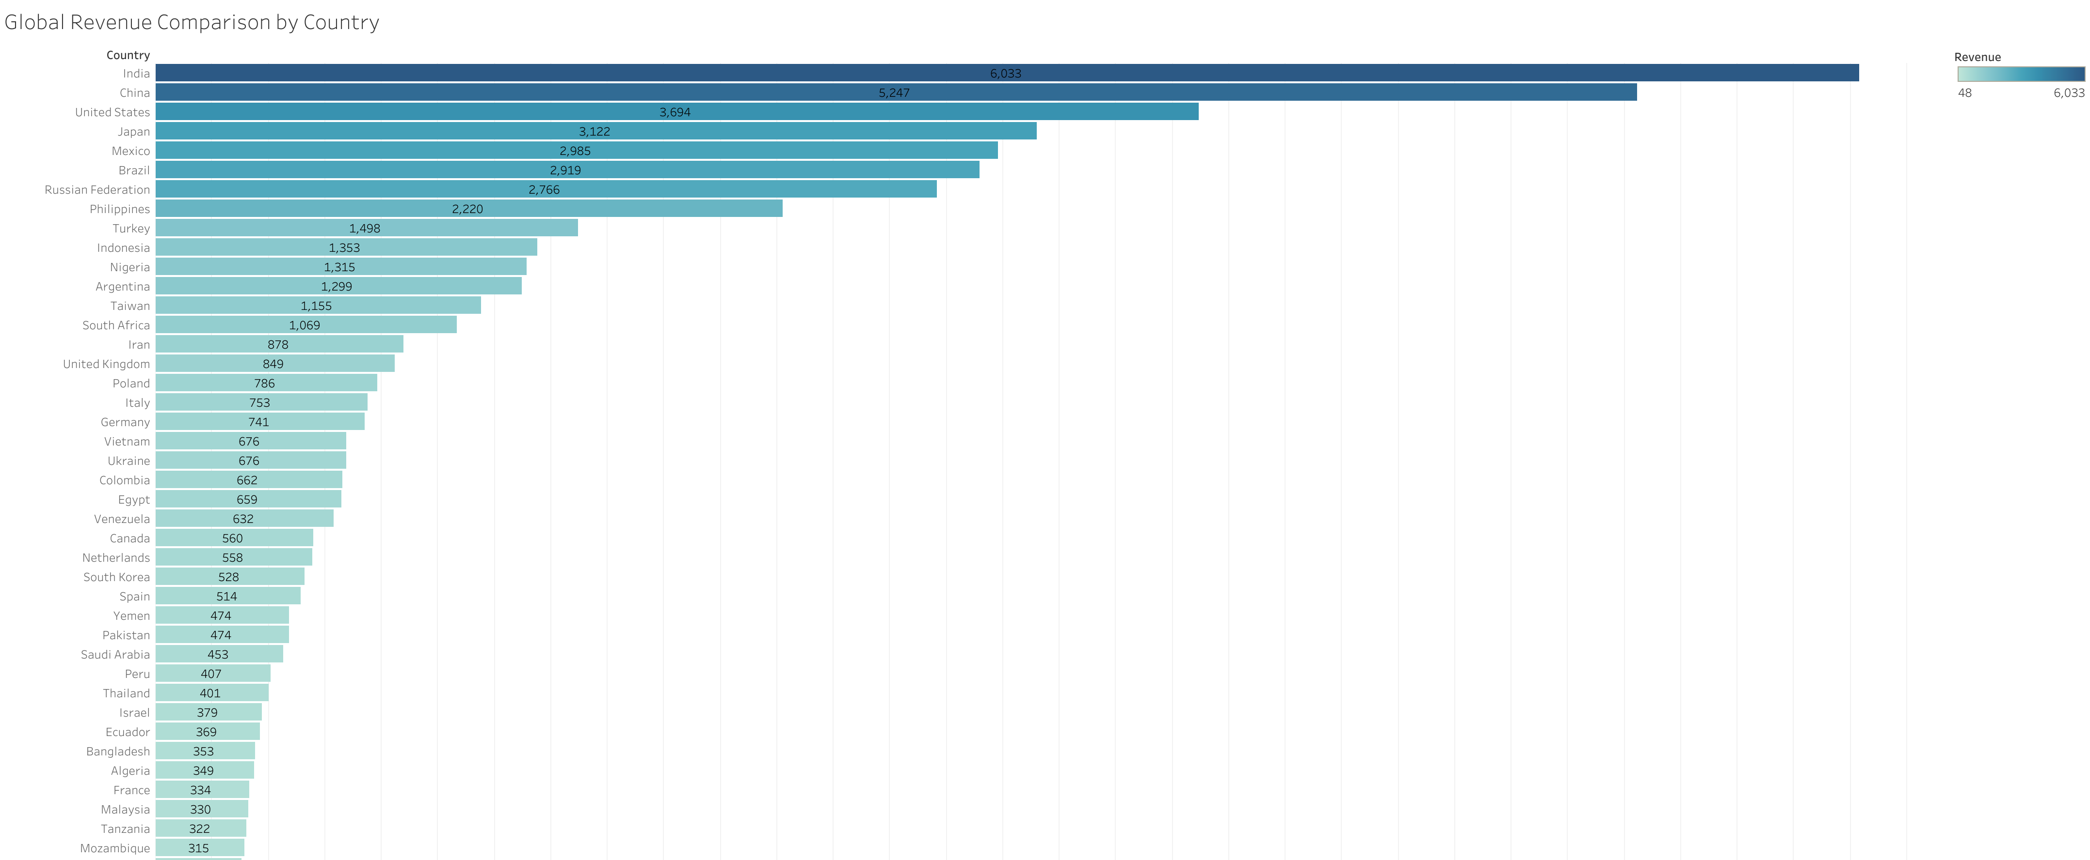
The slide depicts a revenue comparison among participant countries, highlighting India, China, and the United States as the dominant leaders with significantly higher revenue generation compared to other nations.

Slide 7
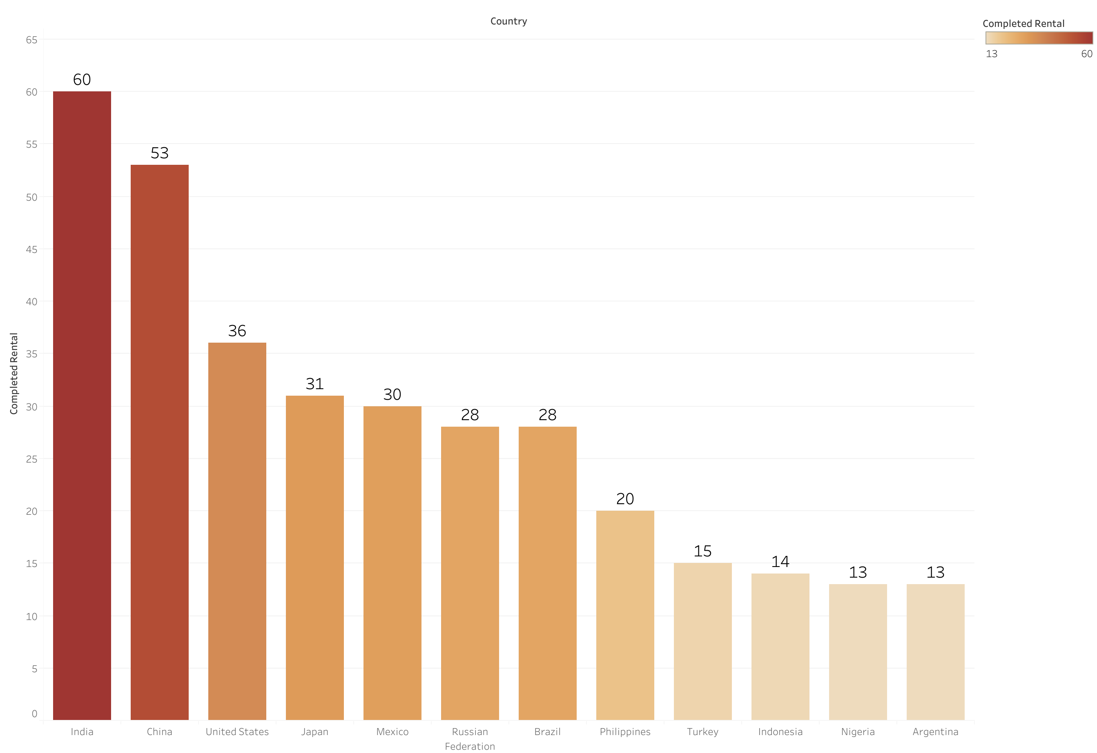
Where are our customers based?

Slide 8
Statistical Analysis
FILM RENTAL
 | Rental Rate | Duration of the rental | Length of the film | Replacement Cost
MIN | $0.99 | 3 | 46 | $9.99
AVG | $2.98 | 4.985 | 115.272 | $19.984
MAX | $4.99 | 4 | 185 | $29.99

Slide 9
Revenue Analysis by Rental Rate for Movie Rentals
Rent price | Rent Count | Count of films | Revenue
$0.99 | 5144 | 341 | 11,916.58
$2.99 | 4670 | 323 | 19,451.27
$4.99 | 4782 | 336 | 29,944.19
The data presents a clear correlation between rental price and revenue generated.
The dataset reveals a higher revenue from fewer rentals at the premium price of $4.99, suggesting that customers are willing to pay more for select films. Although the $0.99 rentals have the highest transaction volume, they result in the least revenue, indicating that lower prices do not necessarily lead to higher revenue.

Slide 10
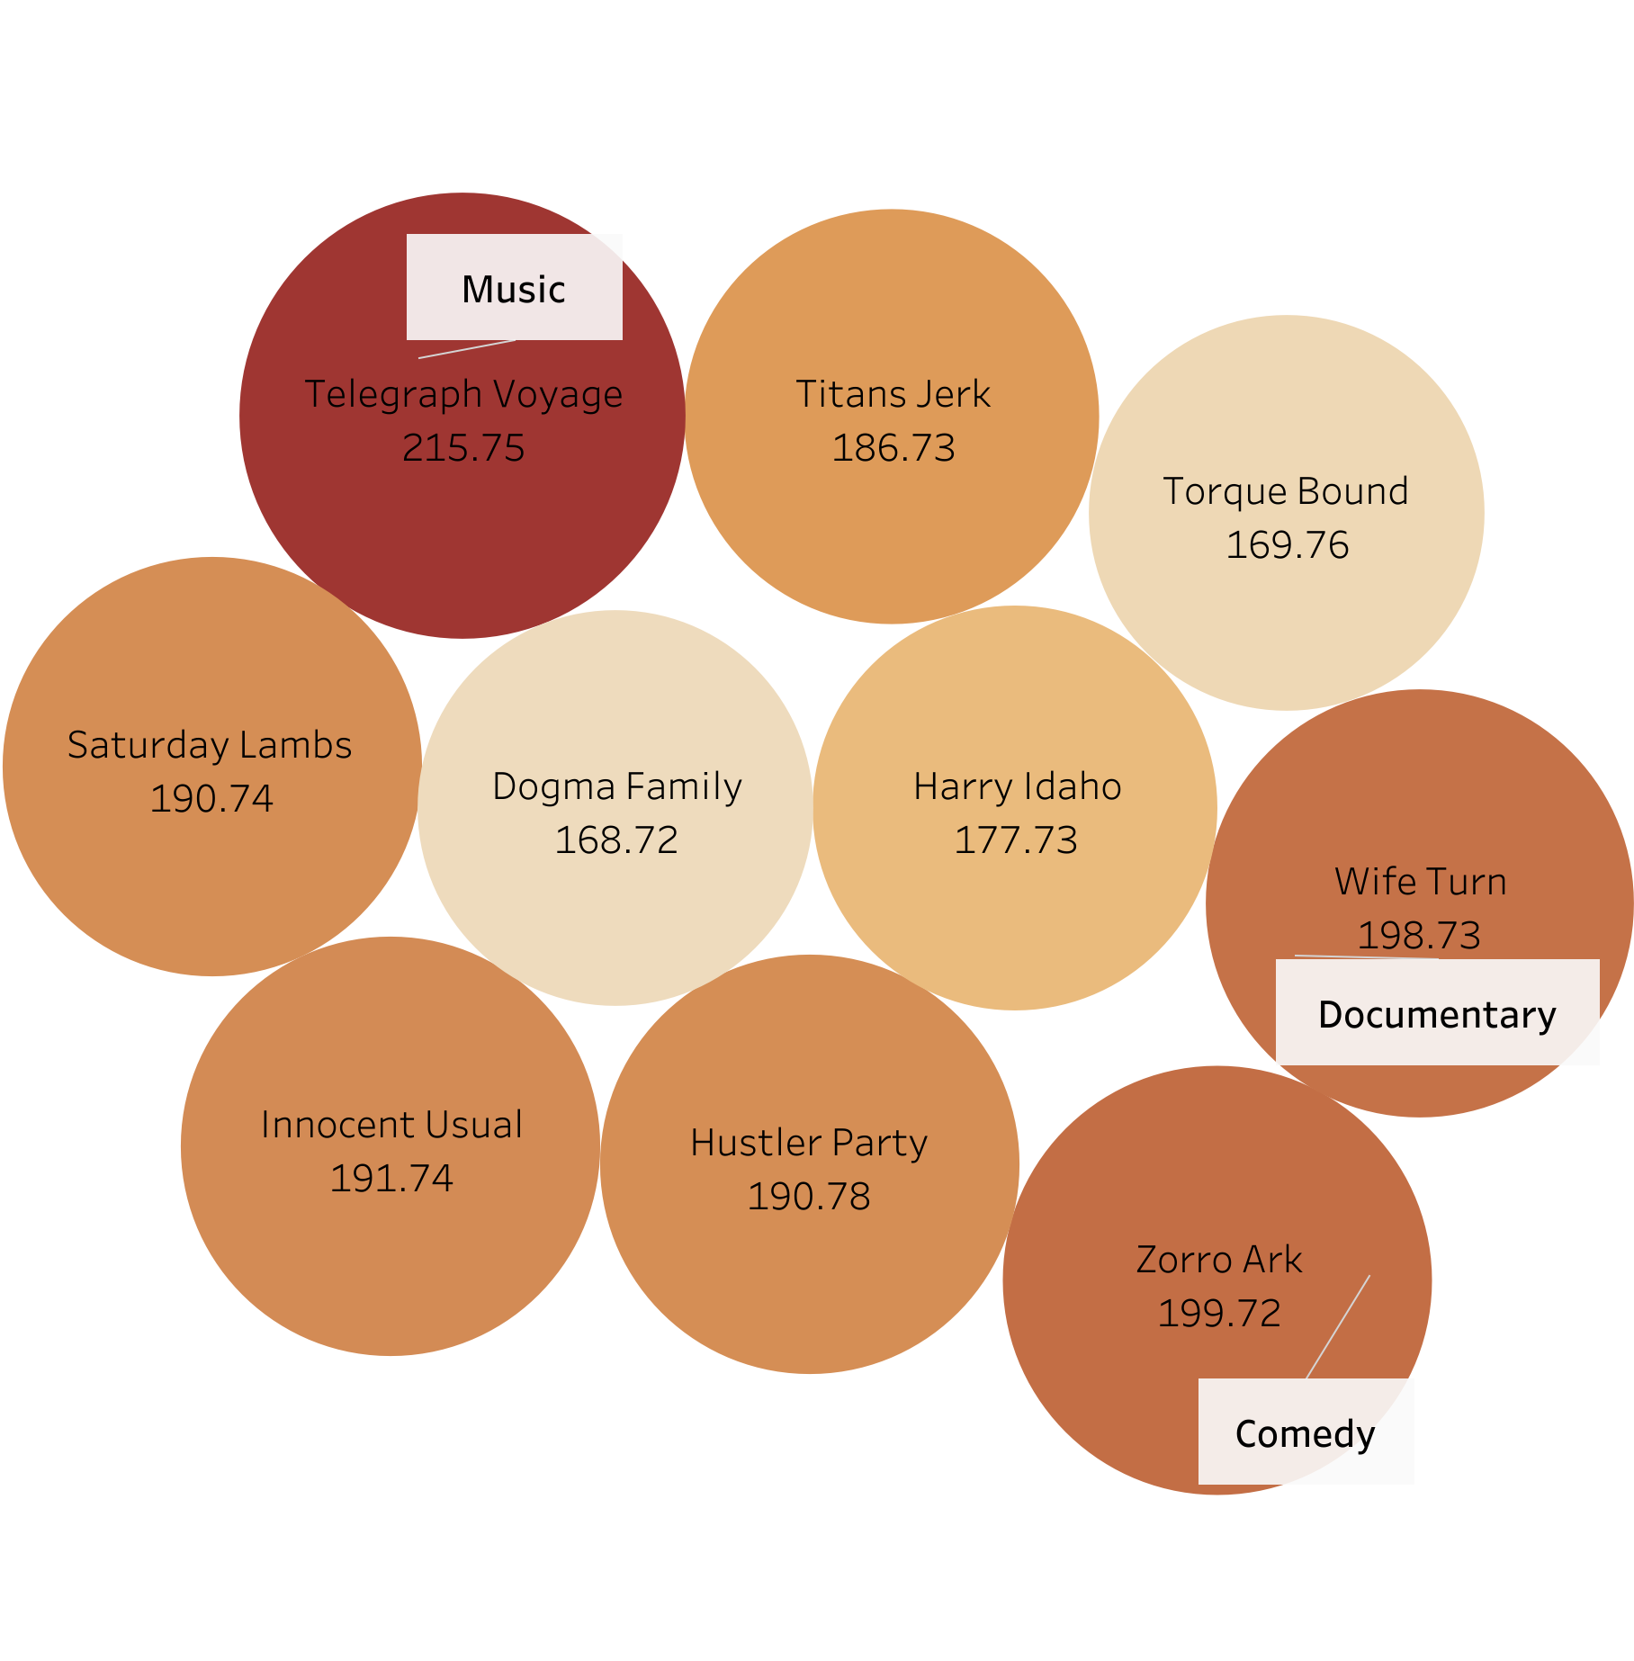
Top 10 Most Profitable Movies
Top 10 movie Most Revenue | Genre
Telegraph Voyage | Music
Zorro Ark | Comedy
Wife Turn | Documentary
Innocent Usual | Foreign
Hustler Party | Comedy
Saturday Lambs | Sports
Titans Jerk | Sci-Fi
Harry Idaho | Drama
Torque Bound | Drama
Dogma Family | Animation

Slide 11
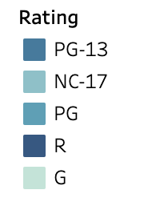
Understand Customer Behavior
Film Popularity by Rating
What types of films are more popular?
The pie chart Film Popularity by Rating suggests customers prefer PG-13 and mature-rated films, with family-friendly G-rated movies being the least rented.

Slide 12
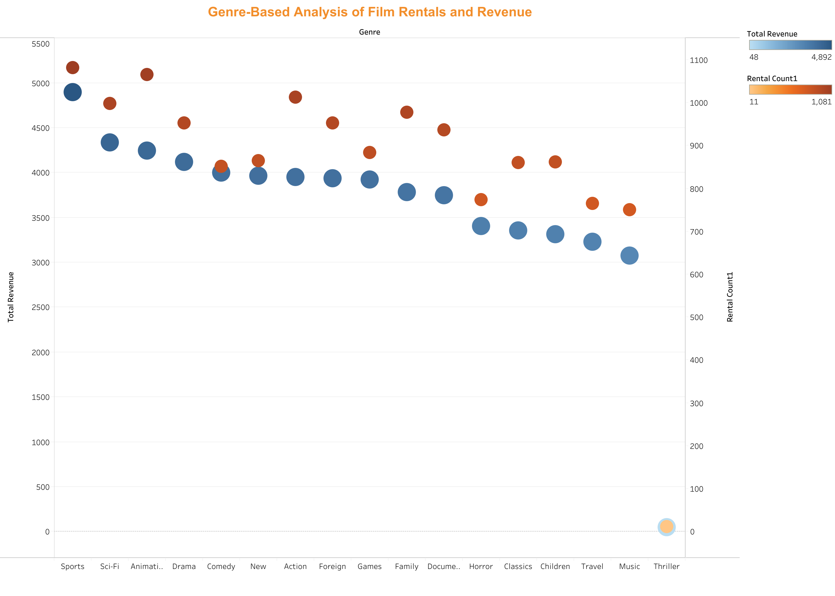
What types of Film Genre customers prefer?
Genres like Sports, Sci-Fi, and Animation have larger bubbles situated higher on the chart, indicating both high rental counts and significant revenue generation.
The Thriller genre, despite a high number of rentals, shows a comparatively smaller bubble, suggesting lower revenue per rental..

Slide 13

Revenue and Rental Comparison: Short vs. Long Duration Films.
Film Length Category | Rental Count | Total Sales
Longest Length | 150 | $678.50
Shortest Length | 91 | $331.09
This data suggests that customers have preference for longer films, which could be perceived as providing more value or entertainment, hence the greater number of rentals and higher total revenue.
Further analysis shows the most rental of the films happens around 3pm and the busiest days are Tuesday, Saturday and Sunday.

Slide 14
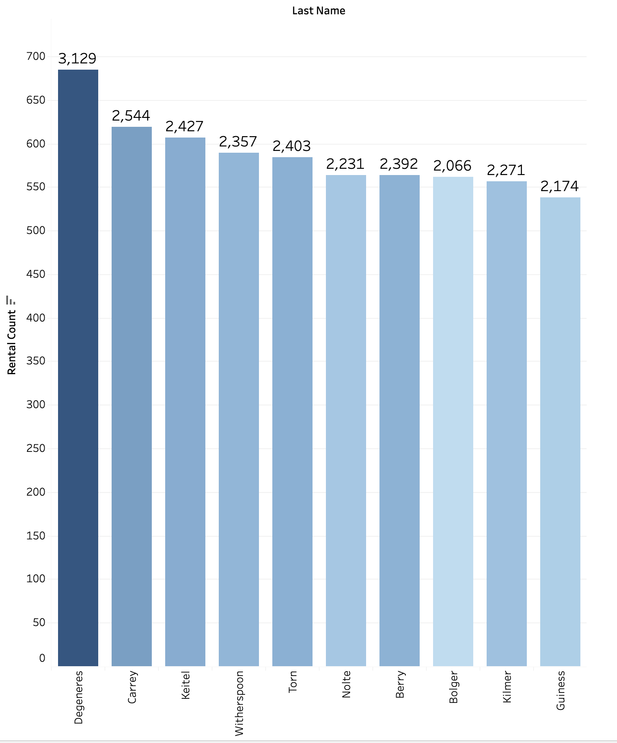
Loyal Customers
The individual with the highest rental count may represent a strong customer preference and could be considered a key influencer in driving rental demand.
There is a relatively consistent rental count among the other names, ranging from 2,174 to 2,544, suggesting a solid group of performers that consistently attract customers.
Data-Driven Decisions: Use these insights to inform future acquisitions or productions, focusing on content that involves the most popular individuals.
Bundle Offers: Create bundle offers or discounts for films involving the top-listed names to encourage customers to explore more titles..
Marketing Campaigns: Leverage the popularity of the top-rented individual by featuring them in marketing campaigns to attract more customers.

Slide 15

Data-Driven Recommendations :
Prioritize restocking genres that have the highest rental counts and revenue, especially those with popular ratings such as PG-13 and mature-rated films.
Implement a dynamic pricing model that mirrors the popularity and profitability of the films, with considerations for higher pricing on new releases and popular titles to boost revenue.
Develop marketing campaigns highlighting the most frequently rented and profitable films and actors, utilizing data to craft personalized customer recommendations.
Offer promotions timed with the most popular rental hours to potentially boost rentals during typically slower periods.
Consider adding more long-duration films to the catalog, as they seem to be more profitable and may reflect a preference among customers for longer film formats.
Utilize customer rental pattern insights to enhance the customer experience by ensuring high-demand titles are in stock and optimizing the rental process for peak times.
By adopting these strategies, the DVD rental company is poised to better match its offerings with what customers want, thereby enhancing satisfaction and driving increased revenue growth.

Slide 16

Appendix
Please follow this link for Data Visualizations in Tableau:
https://public.tableau.com/app/profile/kateryna.hess/viz/Movies_17049963371590/Sheet9

